Slide 1
Project-7
NLP Project for Disaster Tweet Classification
NextHikes Solutions
By - Rakshit A Solanki

Slide 2
Project Overview
Social media platforms like Twitter play an important role in sharing real time information during emergencies and disasters.
Identifying whether a tweet describes a real Disaster or uses Disaster related words in Non-Disaster context can be challenging.
Disaster relief agencies and news organizations can benefit form an automated system that identifies genuine Disaster related tweets quickly.
This project applies Natural Language Processing (NLP) and Machine Learning to classify tweets into Disaster & Non-Disaster
Automated classification system can support faster monitoring of emergency related information available on social media.

Slide 3
Problem Statement
Tweets often contain words such as “fire”, “flood” or “crash” but these words do not always represent an actual disaster.
The same disaster related terms may be used metaphorically, casually or in a completely different context making automatic classification difficult.
The main challenge is to correctly understand the context and intent of tweet text and distinguish genuine disaster information from non-disaster content.
The project aims to develop a binary text classification model that predicts whether a given tweet is real disaster (1) or non-disaster (0).

Slide 4
Dataset Information
Dataset structure
  The dataset contains 7613 tweets with 5 columns.
  Each row represents one tweet along with its related information.
  The main text column is text while target is used for classification.
Important variables
  id : Unique id for each tweet.
  Keyword : Important keyword related to the tweet.
  Target : Final Class 0 for Non-Disaster & 1 for Disaster.
Target Distribution
  Non-Disaster Tweets : 4342
  Disaster Tweets : 3271

Slide 5
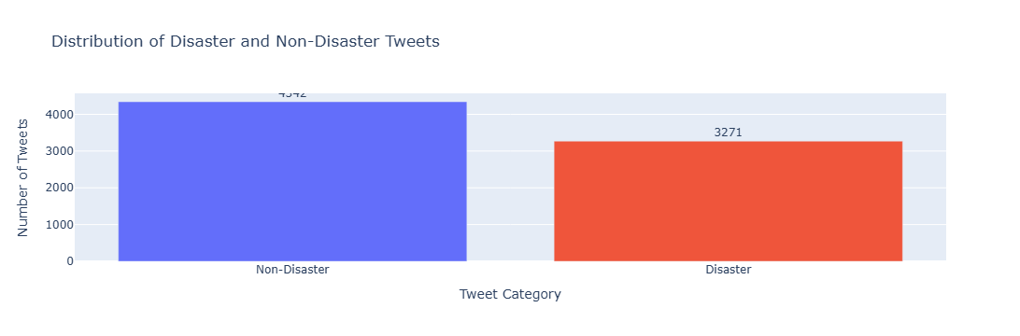
Univariate Analysis
The target variable contains two classes Disaster & Non-Disaster.
4342 tweets are classified as Non-Disaster.
3271 tweets are classified as Disaster.
Non-Disaster tweets are slightly higher than Disaster tweets.

Slide 6
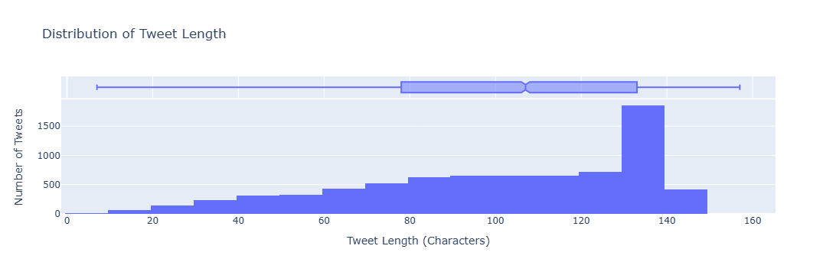
Univariate Analysis
Tweet length was analyzed to understand the size & variation of individual tweets.
Most tweets are concentrated around 80-140 characters.
Very short and very long tweets are comparatively less common.
The distribution shows that users generally provide a moderate amount of text while posting tweets.

Slide 7
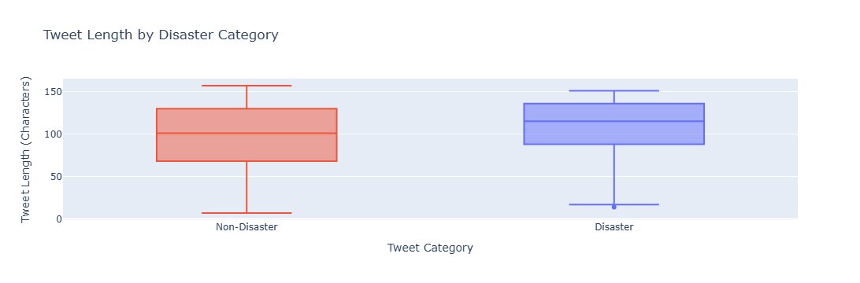
Bivariate Analysis
Disaster tweets generally have a higher median tweet length than Non-Disaster tweets.
Non-Disaster tweets show a wider spread especially toward shorter tweet lengths.
Both categories contain tweets with a wide range of character lengths.

Slide 8
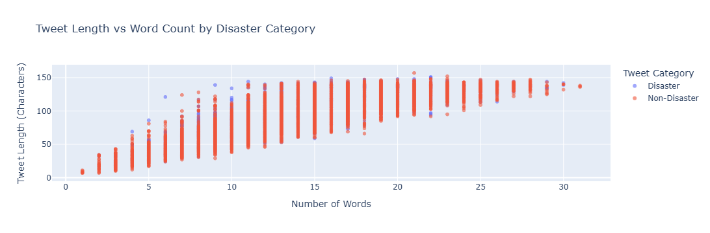
Multivariate Analysis
Tweet length & word count show a strong positive relationship.
Tweet containing more words generally have a higher character length.
Disaster & Non-Disaster tweets show considerable overlap across this relationship.
Therefore, tweet length and word count alone cannot clearly separate the two classes.

Slide 9
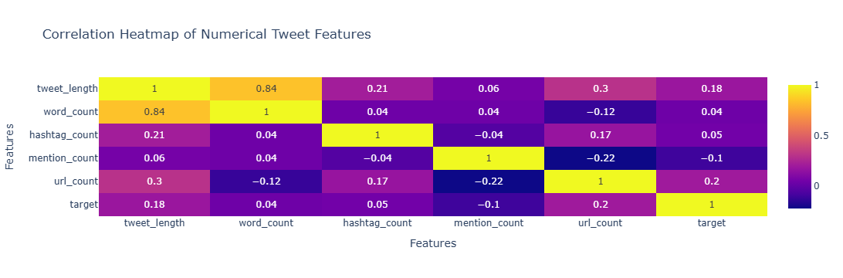
Correlation Heatmap
Tweet length & word count show a strong positive correlation.
Features such as hashtags, mentions & URLs show a different levels of relationship with other tweet characteristics.
The target variable does not show a very strong linear relationship with any single numerical feature.
This indicates that text-based NLP features are important for accurately classifying Disaster & Non-Disaster tweets.

Slide 10
Text Preprocessing
All text was converted to lowercase for consistency.
URLs, user mentions, punctuation & special character were removed.
The cleaned text was tokenized into individual words.
Common English stopwords were removed to keep meaningful words.
The hashtag (#) was removed while keeping the useful hashtag text.
Extra spaces and unnecessary text patterns were removed to create clean text.
The processed tokens were joined back into cleaned text for further NLP analysis.

Slide 11
Feature Engineering
Bag of Words (BOW) was first used to represent words based on their occurrence in tweets.
TF IDF vectorization was applied to give higher importance to more informative words.
The TF IDF representation was limited to 5000 text features for efficient model training.
VADER Sentiment analysis was also performed to generate Positive, Negative, Neutral & Compound sentiment scores.
TF IDF was used as the main text representation for training the final Machine Learning models.

Slide 12
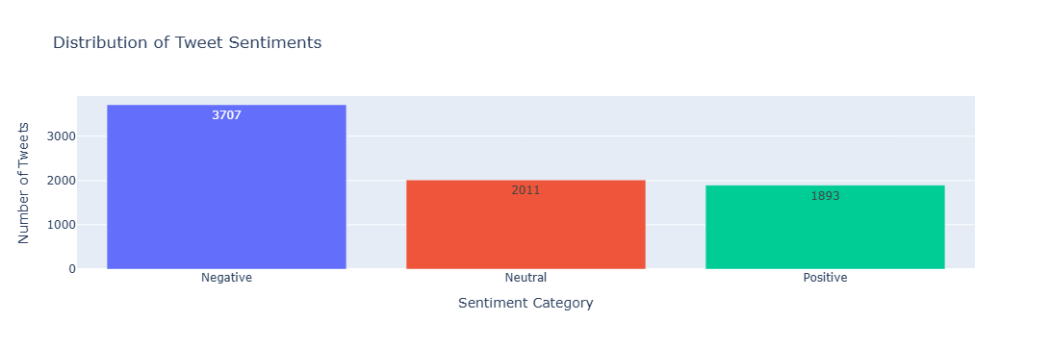
Sentiment Analysis
VADER Sentiment Analysis was applied to understand the emotional tone of tweets.
Each tweet received Positive, Negative, Neutral & Compound sentiment scores.
The compound score was used to classify tweets into Positive, Negative or Neutral sentiment.

Slide 13
Train-Test-Split
A stratified Train-Test-Split was used to maintain a similar Disaster & Non-Disaster class Distribution.
Training data was used to learn the classification patterns while testing data was kept separate for final evaluation.
TF IDF features were prepared for the training and testing text before model building.
Total Dataset : 7613 Tweets
80% Training : 6088 Tweets
20% Testing : 1523 Tweets

Slide 14
Machine Learning Models
Logistic Regression
  Used as a strong baseline model for text classification.
  Works efficiently with high dimensional TF IDF features.
  Provided the best initial overall performance among the tested models.
Random Forest
  An ensemble model based on multiple decision trees.
  Used to compare a tree-based approach with other classifiers.
  Captures more complex patterns in the feature space.
Multinomial Naive Bayes
  Commonly used for NLP and text classification tasks.
  Works effectively with word frequency and TF IDF based features.

Slide 15
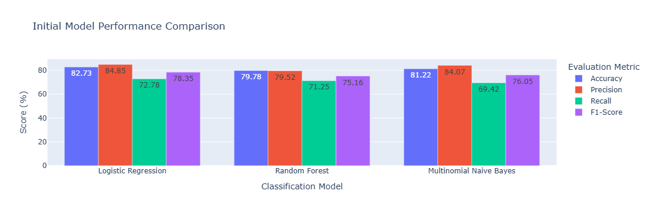
Model Performance Comparison
Logistic Regression achieved the highest initial accuracy of 82.73%.
It also achieved the highest initial F1 score of 78.35%.
Multinomial Naive Bayes showed competitive performance with 81.22% accuracy.
Random Forest showed comparatively lower performance across the evaluation metrics.

Slide 16
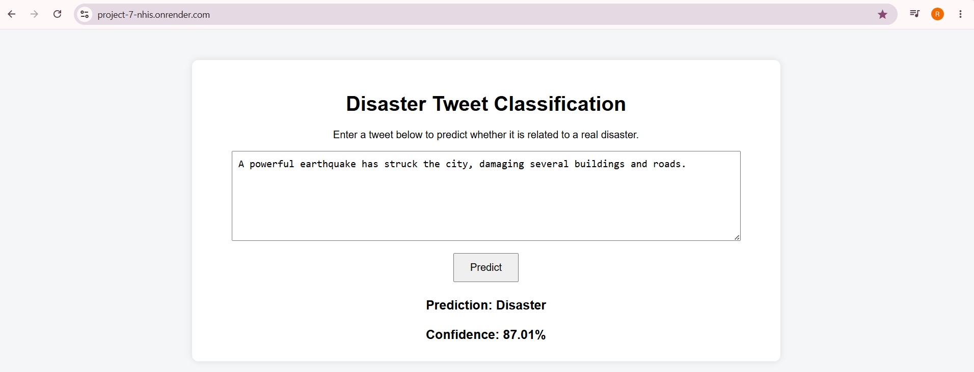
Web Application & Cloud Deployment
The final Logistic Regression model and TF IDF vectorizer were saved for deployment.
A Flask web application was developed to accept tweet text from users.
The application processes the tweet and predicts Disaster or Non-Disaster.
The prediction result is displayed along with a confidence score.
The project was uploaded to GitHub & deployed on Render Cloud.

Slide 17
Business Insights
Enables faster identification of Disaster related tweets from large volumes of social media data.
Reduces the manual effort required to review and filter tweets.
Helps prioritize potentially important emergency related information for further review.
Supports real-time classification of new tweets through the deployed web application.
Can assist news organizations and Disaster response teams in monitoring emergency related social media information.
Provides a scalable approach for automated social media monitoring.

Slide 18
Conclusion
NLP & Machine Learning were successfully used to classify tweets into Disaster & Non-Disaster categories.
TF IDF provided an effective numerical representation of the cleaned tweet text.
Logistic Regression showed strong overall performance while the tuned model improved Disaster Recall.
The final model was successfully integrated into a Flask web application and deployed on Render.
The project demonstrates a practical approach for automated Disaster related social media monitoring.

Slide 19
Reference Links Used For Learn
https://www.geeksforgeeks.org/data-analysis/exploratory-data-analysis-in-python/
https://www.geeksforgeeks.org/nlp/text-preprocessing-for-nlp-tasks/
https://www.geeksforgeeks.org/machine-learning/text-classification-using-logistic-regression/
https://www.geeksforgeeks.org/machine-learning/multinomial-naive-bayes/
https://www.geeksforgeeks.org/machine-learning/classification-of-text-documents-using-the-approach-of-naive-bayes/
https://flask.palletsprojects.com/en/stable/quickstart/
https://render.com/docs/deploy-flask

Slide 20
Thank You

